Slide 1
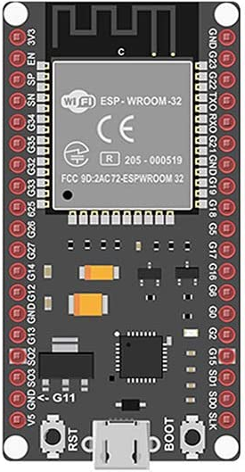
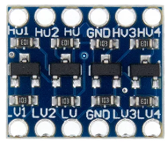


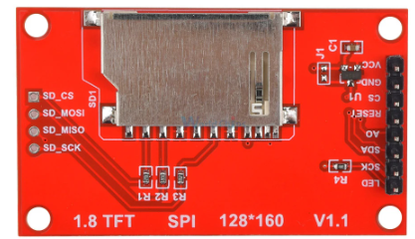
CAM_VOUT
CAM_GND
CAM_VCC
CAM_READ
CAM_CLOCK
+3.3V
CAM_RESET
CAM_LOAD
CAM_SIN
CAM_START
READ
+5V
CLOCK
FREE
FREE
RESET
START
LOAD
SIN
FREE
FREE
Main ON/OFF

